Slide 1
Tests of Hypotheses for a Single Sample

Slide 2
LO
Formulate the two hypotheses; identify critical values, test statistic and compute P-value for a test of hypotheses
on population mean.
population proportion.
population variance.
Identify type of errors in testing hypotheses.

Slide 3
Introduction
A longtime authorized user of the account makes 0.2 seconds between keystrokes. One day, the following times between keystrokes were recorded when a user typed correctly username and password: 0.24, 0.22, 0.26, 0.34, 0.35, 0.32, 0.33, 0.29, 0.19, 0.36, 0.30, 0.15, 0.17, 0.28, 0.38, 0.40, 0.37, 0.27.
Is he/she an authorized use of a computer account assuming Normal distribution of these times?

Slide 4
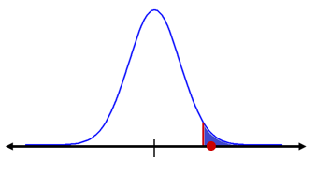
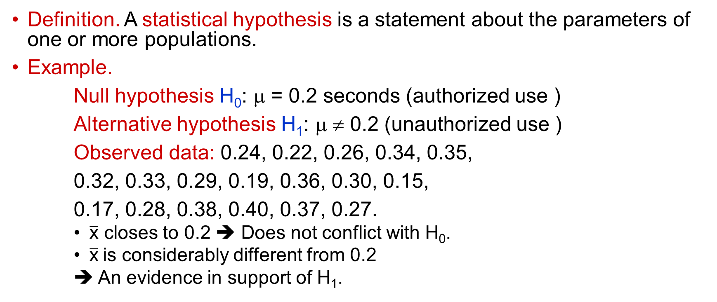
Statistical hypothesis
Definition. A statistical hypothesis is a statement about the parameters of one or more populations.
Example.
Null hypothesis H₀: μ = 0.2 seconds (authorized use )
Alternative hypothesis H₁: μ ≠ 0.2 (unauthorized use )
Observed data: 0.24, 0.22, 0.26, 0.34, 0.35,
0.32, 0.33, 0.29, 0.19, 0.36, 0.30, 0.15,
0.17, 0.28, 0.38, 0.40, 0.37, 0.27.
$\overline{\text{x}}$ closes to 0.2 ➔ Does not conflict with H₀.
$\overline{\text{x}}$is considerably different from 0.2
➔ An evidence in support of H₁.
Small area/probability
0.2
Observed data
does not support H₀

Slide 5
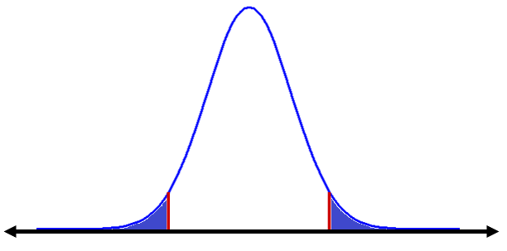
H₀: μ = μ₀
H₁: μ ≠ μ₀
Observed data shows strong evidence to reject H₀
Observed data shows evidence that supports H₀
•
| •
μ₀
| •
Critical region
Acceptance region
Critical
region
Critical value
Critical value

Slide 6
Significance level α and Types of errors
H₀ is true
We can make errors!
Type I error: Reject H₀ when H₀ is actually true
α = 0.05 is probability of type I error
α: significance level, or the α-error, or the size of the test (usual α is in [0.01, 0.1])
Area = α/2
Area = α/2
| •
If observed data falls in the critical region (probability = α/2 + α /2 = α)
➔ We reject H₀
Note. Type II error: Fail to reject H₀ when H₀ is actually false.

Slide 7
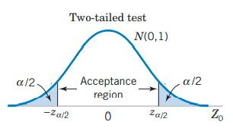
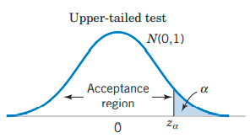
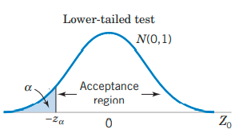
One-Sided and Two-Sided Tests
Two-tailed Hypotheses | One-tailed Hypotheses
H₀: μ = μ₀ H₁: μ ≠ μ₀ | H₀: μ = μ₀ H₁: μ > μ₀ | H₀: μ = μ₀ H₁: μ < μ₀
Example (one-tailed hypotheses). To verify that the average connection speed is 54 Mbps, we test the null hypothesis H₀ : µ = 54 against the alternative hypothesis H₁ : µ < 54, because we worry about a low connection speed.

Slide 8
Hypothesis Tests process
Parameter
Hypothesis H₀ vs H₁
Alpha significance level α
Related to test statistic
H₀ should be rejected (?)
A sample
Obtain a value using sample
PHARAOH process

Slide 9
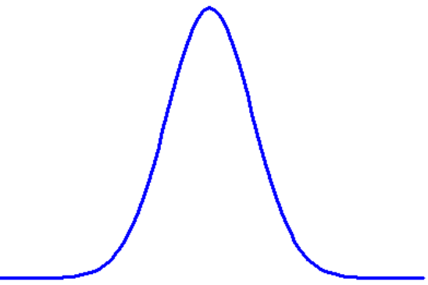
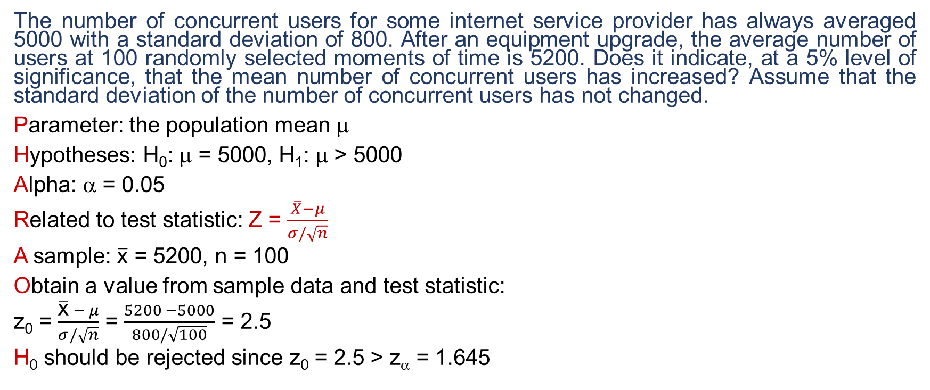
Example
The number of concurrent users for some internet service provider has always averaged 5000 with a standard deviation of 800. After an equipment upgrade, the average number of users at 100 randomly selected moments of time is 5200. Does it indicate, at a 5% level of significance, that the mean number of concurrent users has increased? Assume that the standard deviation of the number of concurrent users has not changed.
Parameter: the population mean μ
Hypotheses: H₀: μ = 5000, H₁: μ > 5000
Alpha: α = 0.05
Related to test statistic: Z = $\frac{\overline{X}−μ}{σ/\sqrt{n}}$
A sample: $\overline{\text{x}}$ = 5200, n = 100
Obtain a value from sample data and test statistic:
z₀ = $\frac{\overline{\text{x}} − μ}{σ/\sqrt{n}}$ = $\frac{5200 −5000}{800/\sqrt{100}}$ = 2.5
H₀ should be rejected since z₀ = 2.5 > z_{α} = 1.645
H₀: μ = 5000
H₁: μ > 5000
Area =
α = 0.05
|
|
0
•
1.645
z₀ = 2.5

Slide 10
H₀: μ = 5000
H₁: μ > 5000
Area =
α = 0.05
|
|
0
•
1.645
z₀ = 2.5

Slide 11
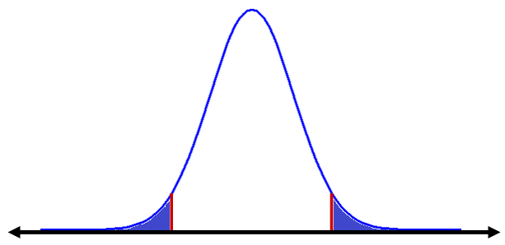
Computing P-value
Two-sided test
When H₀ is true,
P-value = P = P{Z > z₀} + P{Z < -z₀}
= 2[1 – Φ(|z₀|)]
P/2
P/2
|
-z₀
0 z₀

Slide 12
P-value
Increase level of significance
///////
| | |
1 P-value 0
////////////
α
Reject H₀
with these α
Fail to reject H₀
with these α
Definition. The P-value (computed from observed data) is the smallest level of significance that would lead to rejection of the null hypothesis H₀ with the given data.
α < P-value > ➔ Fail to reject the null hypothesis H₀.
α  P-value ➔ H₀ should be rejected
(Usual significance levels α∈[0.01, 0.1])

Slide 13
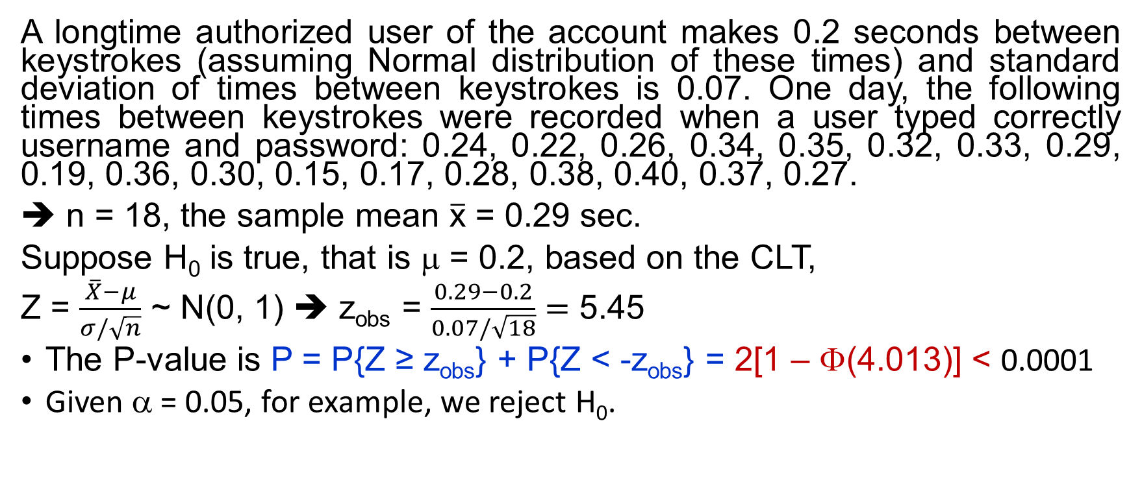
P-value - Example
A longtime authorized user of the account makes 0.2 seconds between keystrokes (assuming Normal distribution of these times) and standard deviation of times between keystrokes is 0.07. One day, the following times between keystrokes were recorded when a user typed correctly username and password: 0.24, 0.22, 0.26, 0.34, 0.35, 0.32, 0.33, 0.29, 0.19, 0.36, 0.30, 0.15, 0.17, 0.28, 0.38, 0.40, 0.37, 0.27.
➔ n = 18, the sample mean $\overline{\text{x}}$ = 0.29 sec.
Suppose H₀ is true, that is μ = 0.2, based on the CLT,
Z = $\frac{\overline{X}−μ}{σ/\sqrt{n}}$ ~ N(0, 1) ➔ z_{obs} = $\frac{0.29−0.2}{0.07/\sqrt{18}}=$ 5.45
The P-value is P = P{Z ≥ z_{obs}} + P{Z < -z_{obs}} = 2[1 – Φ(4.013)] < 0.0001
Given α = 0.05, for example, we reject H₀.
Notes:
P-value = 2*(1-pnorm(4.013))

Slide 14
P-value < 0.001 < 0.025
|
-z₀
0 z₀
z_{0.025}

Slide 15
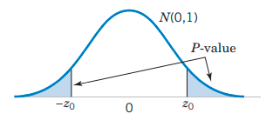
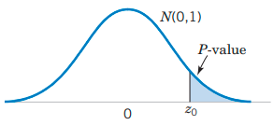
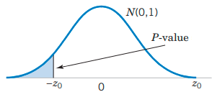
One-Sided and Two-Sided Tests
Two-sided Hypotheses | One-sided Hypotheses
H₀: μ = μ₀ H₁: μ ≠ μ₀ | H₀: μ = μ₀ H₁: μ > μ₀ | H₀: μ = μ₀ H₁: μ < μ₀

Slide 16
Common Parameters in Hypothesis Testing
Test on
Mean μ
Proportion p
Variance σ²

Slide 17
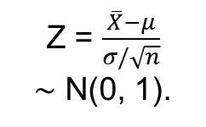
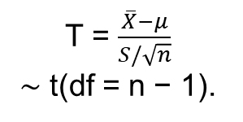
Hypothesis Tests on the Mean
Test on
μ
t-test
z-test
Normally distributed population
Unknown
σ²
Known
σ²
T = $\frac{\overline{X}−μ}{S/\sqrt{n}}$
∼ t(df = n − 1).
Z = $\frac{\overline{X}−μ}{σ/\sqrt{n}}$
∼ N(0, 1).

Slide 18
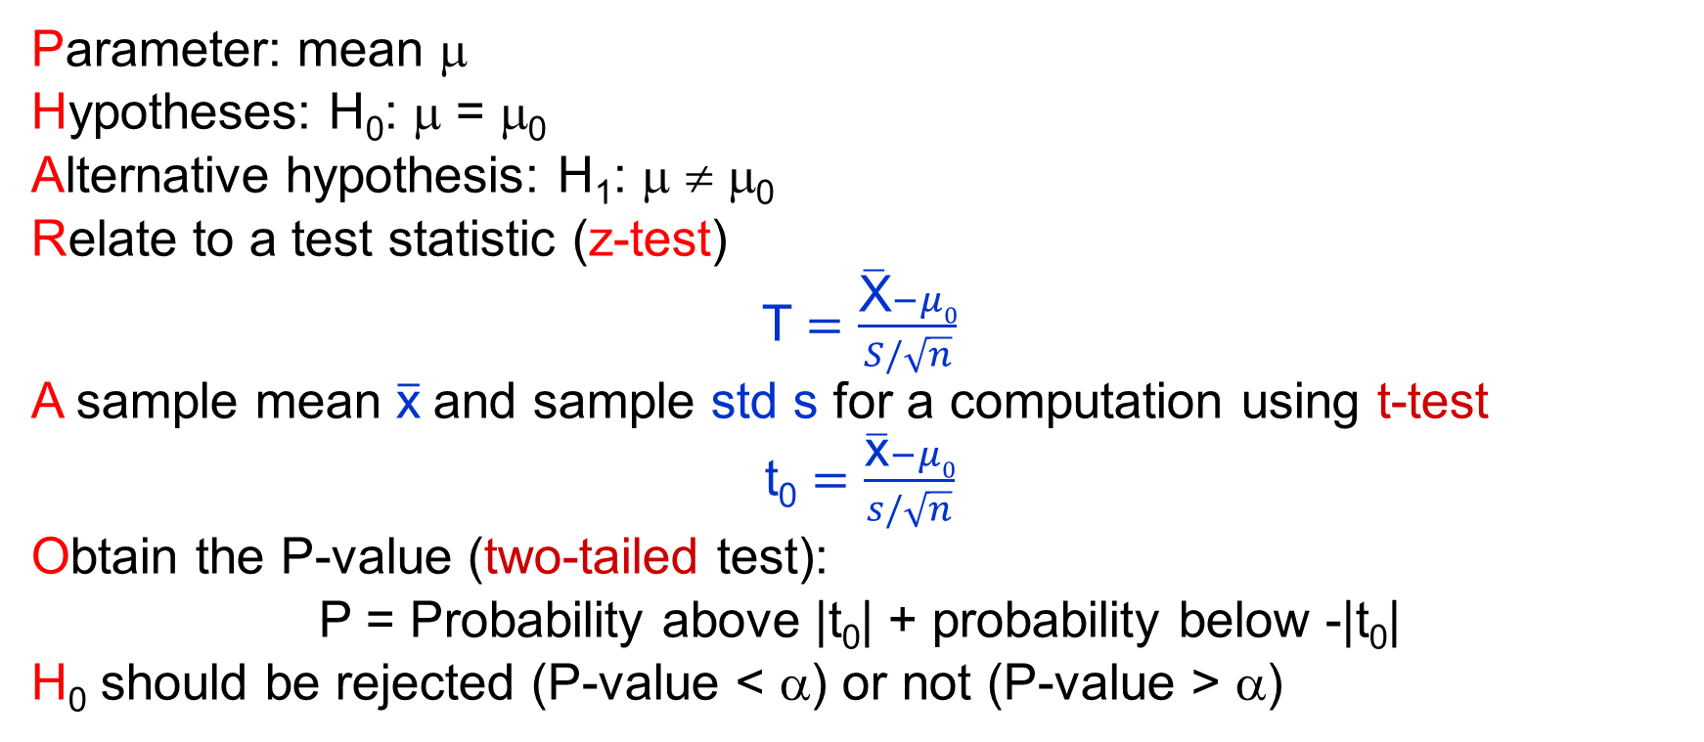
Hypothesis Tests on the Mean (t-test)
Parameter: mean μ
Hypotheses: H₀: μ = μ₀
Alternative hypothesis: H₁: μ ≠ μ₀
Relate to a test statistic (z-test)
T $=\frac{\overline{\text{X}}−μ0}{S/\sqrt{n}}$
A sample mean $\overline{\text{x}}$and sample std s for a computation using t-test
t₀ $=\frac{\overline{\text{x}}−μ0}{s/\sqrt{n}}$
Obtain the P-value (two-tailed test):
P = Probability above |t₀| + probability below -|t₀|
H₀ should be rejected (P-value < α) or not (P-value > α)

Slide 19
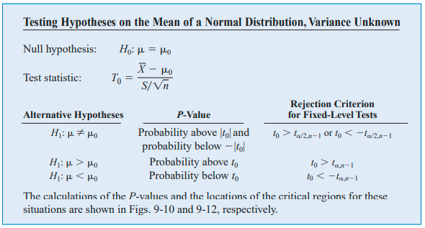
T-test

Slide 20
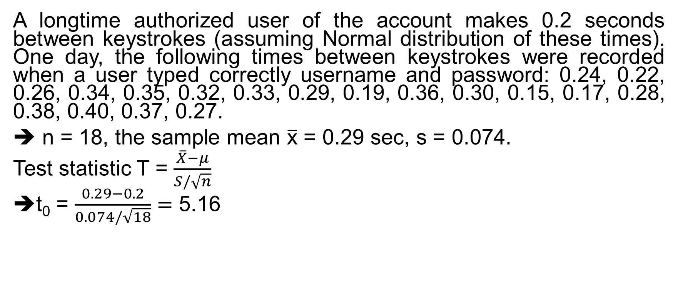
t-test (unknown σ² case) - Example
A longtime authorized user of the account makes 0.2 seconds between keystrokes (assuming Normal distribution of these times). One day, the following times between keystrokes were recorded when a user typed correctly username and password: 0.24, 0.22, 0.26, 0.34, 0.35, 0.32, 0.33, 0.29, 0.19, 0.36, 0.30, 0.15, 0.17, 0.28, 0.38, 0.40, 0.37, 0.27.
➔ n = 18, the sample mean $\overline{\text{x}}$ = 0.29 sec, s = 0.074.
Test statistic T = $\frac{\overline{X}−μ}{S/\sqrt{n}}$
t₀ = $\frac{0.29−0.2}{0.074/\sqrt{18}}=$ 5.16

Slide 21
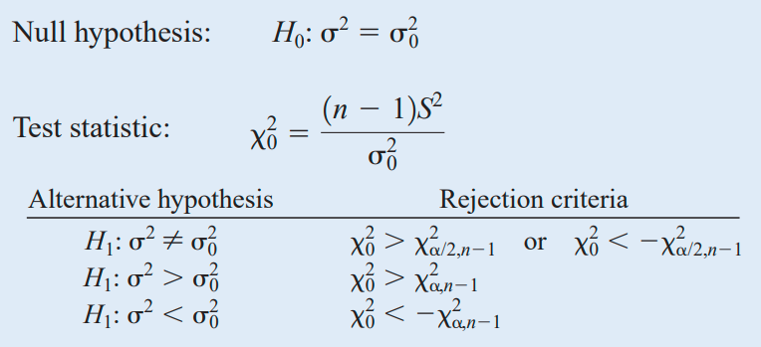
χ²-test on σ²
Test on σ²
χ² - test

Slide 22
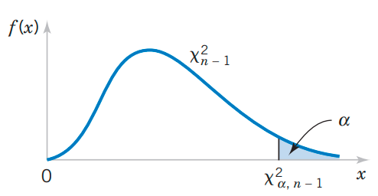
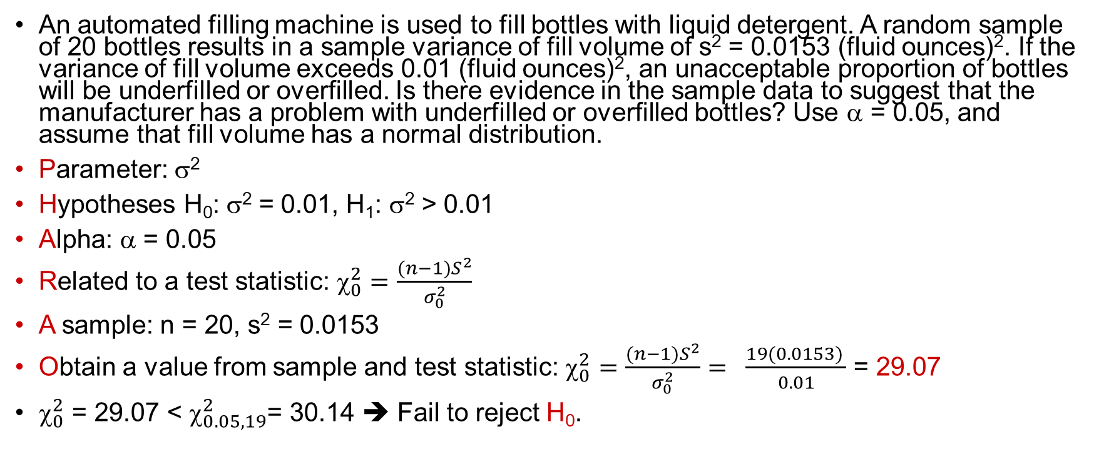
χ²-test - example
An automated filling machine is used to fill bottles with liquid detergent. A random sample of 20 bottles results in a sample variance of fill volume of s² = 0.0153 (fluid ounces)². If the variance of fill volume exceeds 0.01 (fluid ounces)², an unacceptable proportion of bottles will be underfilled or overfilled. Is there evidence in the sample data to suggest that the manufacturer has a problem with underfilled or overfilled bottles? Use α = 0.05, and assume that fill volume has a normal distribution.
Parameter: σ²
Hypotheses H₀: σ² = 0.01, H₁: σ² > 0.01
Alpha: α = 0.05
Related to a test statistic: ${\text{}}_{0}^{2}=$ $\frac{(n−1)S^{2}}{σ_{0}^{2}}$
A sample: n = 20, s² = 0.0153
Obtain a value from sample and test statistic: ${\text{}}_{0}^{2}=$ $\frac{(n−1)S^{2}}{σ_{0}^{2}}= \frac{19(0.0153) }{0.01}$ = 29.07
${\text{}}_{0}^{2}$ = 29.07 < ${\text{}}_{0.05, 19}^{2}$= 30.14 ➔ Fail to reject H₀.
29.07
•

Slide 23
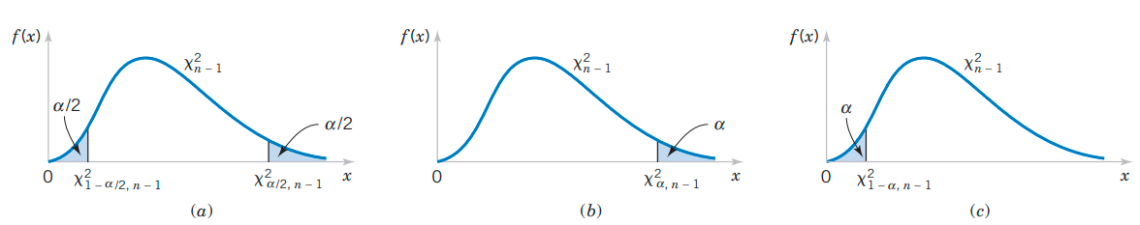
χ²-test
(a) H₁: σ² ≠ σ₀²
(b) H₁: σ² > σ₀²
(c) H₁: σ² < σ₀²

Slide 24
Example
Creators of a new software claim that it measures the remaining notebook battery life with a standard deviation as low as 5 minutes. To test this claim, a fully charged notebook was disconnected from the power supply and continued on its battery. The experiment was repeated 50 times, and every time the predicted battery life was recorded. The sample standard deviation of these 50 normally distributed measurements was equal 5.6 minutes.
At the 1% level of significance, do these data provide evidence that the actual standard deviation is greater than 5 min?
Test H₀ : σ = 5 against a right-tail H₁: σ > 5.

Slide 25
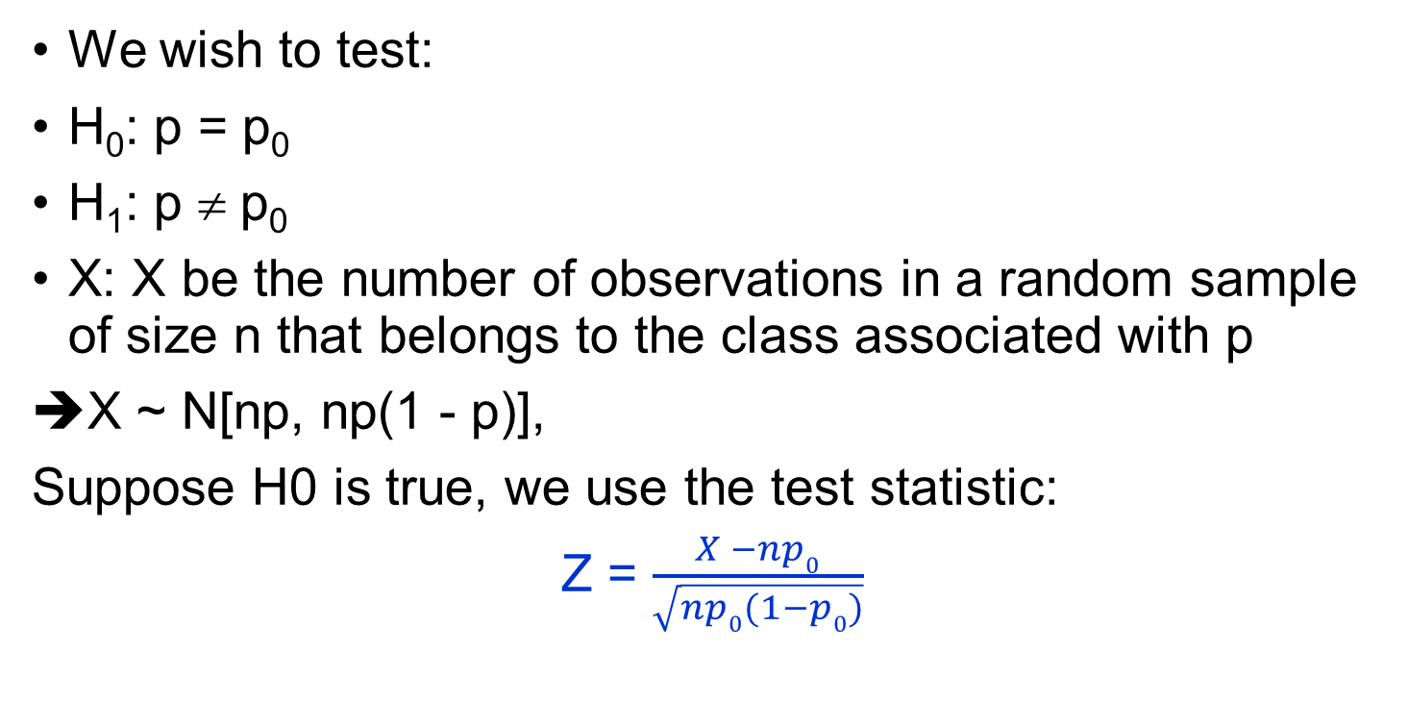
Tests on a Proportion
Test on
proportion
p
We wish to test:
H₀: p = p₀
H₁: p ≠ p₀
X: X be the number of observations in a random sample of size n that belongs to the class associated with p
X ~ N[np, np(1 - p)],
Suppose H0 is true, we use the test statistic:
Z = $\frac{X −np0}{\sqrt{np0(1−p0)}}$
z - test

Slide 26
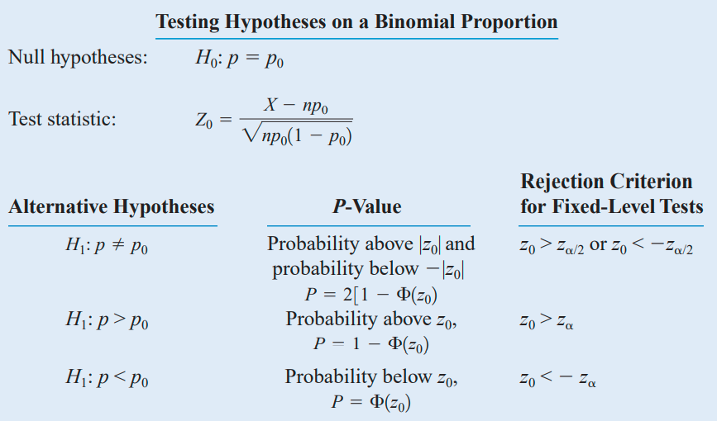
Summary of Approximate Tests on a Binomial Proportion

Slide 27
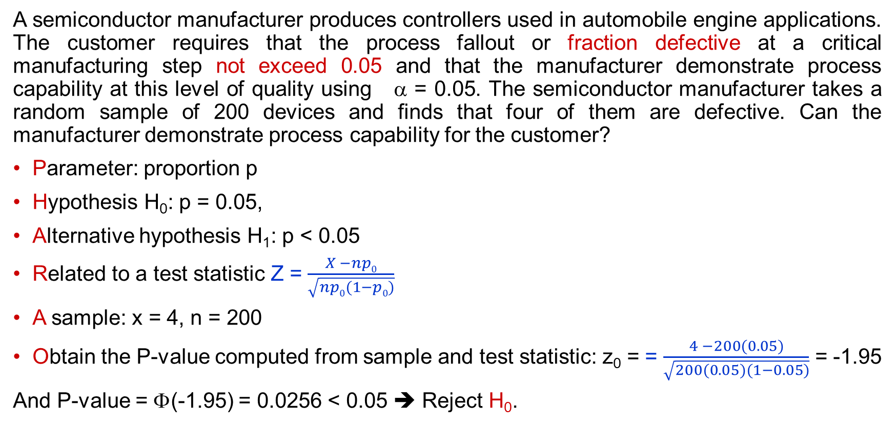
Example
A semiconductor manufacturer produces controllers used in automobile engine applications. The customer requires that the process fallout or fraction defective at a critical manufacturing step not exceed 0.05 and that the manufacturer demonstrate process capability at this level of quality using α = 0.05. The semiconductor manufacturer takes a random sample of 200 devices and finds that four of them are defective. Can the manufacturer demonstrate process capability for the customer?
Parameter: proportion p
Hypothesis H₀: p = 0.05,
Alternative hypothesis H₁: p < 0.05
Related to a test statistic Z = $\frac{X −np0}{\sqrt{np0(1−p0)}}$
A sample: x = 4, n = 200
Obtain the P-value computed from sample and test statistic: z₀ = = $\frac{4 −200(0.05)}{\sqrt{200(0.05)(1−0.05)}}$ = -1.95
And P-value = Φ(-1.95) = 0.0256 < 0.05 ➔ Reject H₀.
Notes:
# Φ(z) in R
pnorm(z)

Slide 28
Exercises
(3x + 7) mod 103
(5x + 9) mod 103
(7x + 11) mod 103

Slide 29
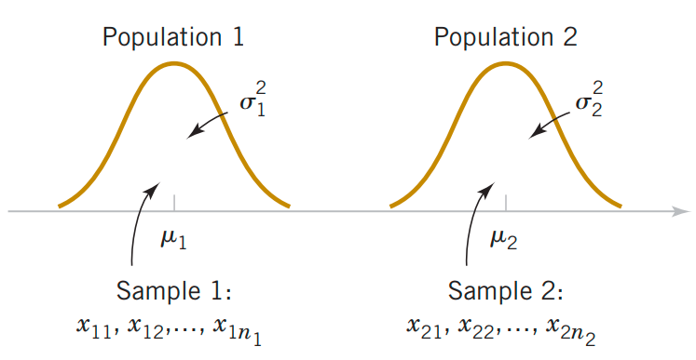
Inference on the Difference in Means of Two Normal Distributions, Variances Known
Assumptions for Two-Sample Inference
X₁₁, X₁₂, …, X_{1n1} is a random sample from population
X₂₁, X₂₂, …, X_{2n2} is a random sample from population
The two populations represented by X₁ and X₂ are independent.
(4) Both populations are normal.
Two independent populations

Slide 30
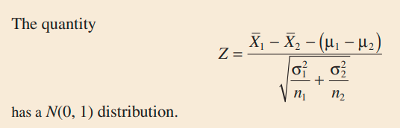
Tests on the Difference in Means, Variances Known

Slide 31
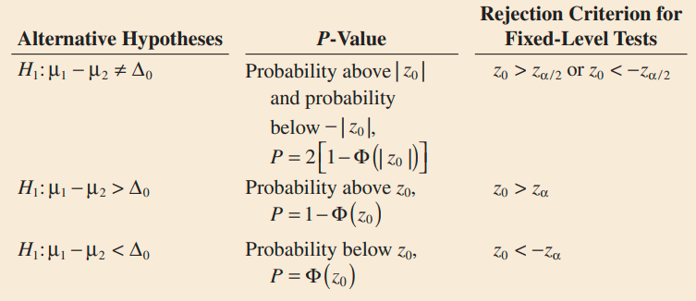
Tests on the Difference in Means, Variances Known
Null hypothesis
and test statistic:
Ex. A manager evaluates effectiveness of a major hardware upgrade by running a certain process 50 times before the upgrade and 50 times after it. Based on these data, the average running time is 8.5 minutes before the upgrade, 7.2 minutes after it. Historically, the standard deviation has been 1.8 minutes, and presumably it has not changed. Test on the difference between the means of running time. Use α = 0.05.

Slide 32

Confidence Interval
Ex. A manager evaluates effectiveness of a major hardware upgrade by running a certain process 50 times before the upgrade and 50 times after it. Based on these data, the average running time is 8.5 minutes before the upgrade, 7.2 minutes after it. Historically, the standard deviation has been 1.8 minutes, and presumably it has not changed. Construct a 95% confidence interval showing how much the mean running time reduced due to the hardware upgrade.

Slide 33
Choice of Sample Size
The sample size required so that the error in estimating μ₁ − μ₂ by x₁ - x₂ will be less than E at 100(1 − α)% confidence.

Slide 34
Unknown σ²
What if variance σ² is unknown?
Use large sample size (n₁ and n₂  30) and sample variance s² instead of population variance σ² which is unknown.
Ex. A test is conducted to compare breaking strength of cell phones manufactured by two companies. Summary data are given below.
Company A: n₁ = 65, ‾x₁ = 107 pounds, s₁ = 10 pounds
Company B: n₂ = 60, ‾x₂ = 113 pounds, s² = 13 pounds
Use α = 0.05.

Slide 35
Example
Parameter of interest: μ₁ − μ₂ and Δ₀ = 0
H₀: μ₁ − μ₂ = Δ₀ = 0
H₁: μ₁ < μ₂
Test statistic:
P-value = P(Z < -2.875) = 0.002
Conclusion: Reject H₀ at the α = 0.05 level

Slide 36
Unknown variances, large samples
Ex. Internet connections are often slowed by delays at nodes. Let us determine if the delay time increases during heavy-volume times. Five hundred packets are sent through the same network between 5 pm and 6 pm (sample X₁), and three hundred packets are sent between 10 pm and 11 pm (sample X₂ ). The early sample has a mean delay time of 0.8 sec with a standard deviation of 0.1 sec whereas the second sample has a mean delay time of 0.5 sec with a standard deviation of 0.08 sec. Construct a 95% confidence interval for the difference between the mean delay times.

Slide 37
Unknown variances, large samples
Ex. Internet connections are often slowed by delays at nodes. Let us determine if the delay time increases during heavy-volume times. Five hundred packets are sent through the same network between 5 pm and 6 pm (sample X₁), and three hundred packets are sent between 10 pm and 11 pm (sample X₂). The early sample has a mean delay time of 0.8 sec with a standard deviation of 0.1 sec whereas the second sample has a mean delay time of 0.5 sec with a standard deviation of 0.08 sec. Test on the difference between the mean delay times at 0.05 level of significance.

Slide 38
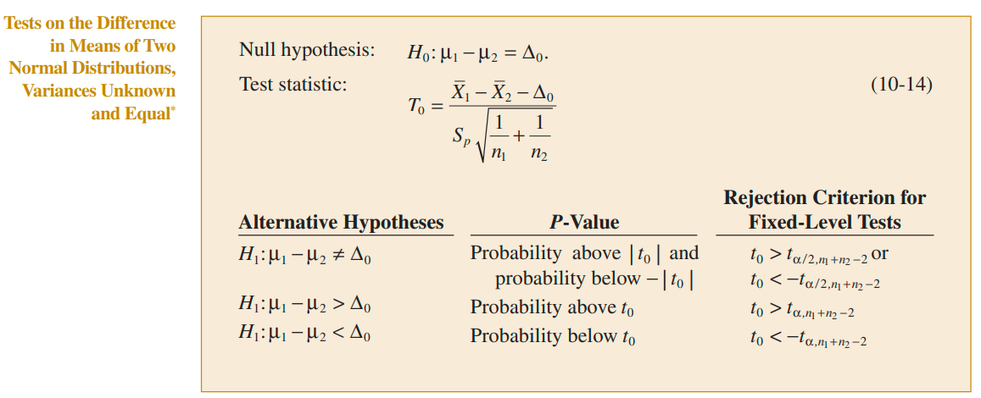
Unknown variance, small samples

Slide 39
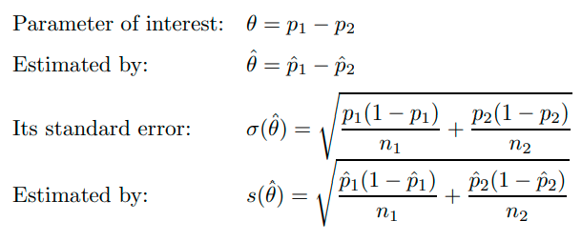
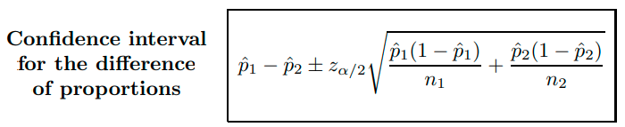
On the difference of proportions

Slide 40
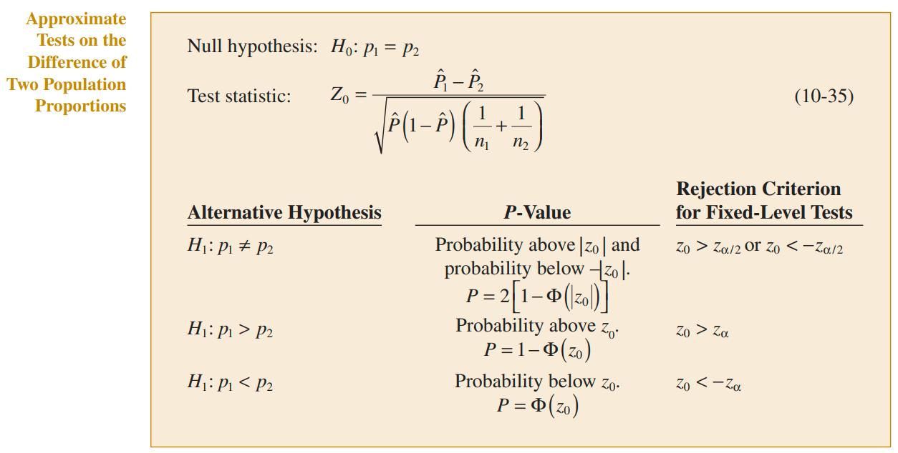

Slide 41
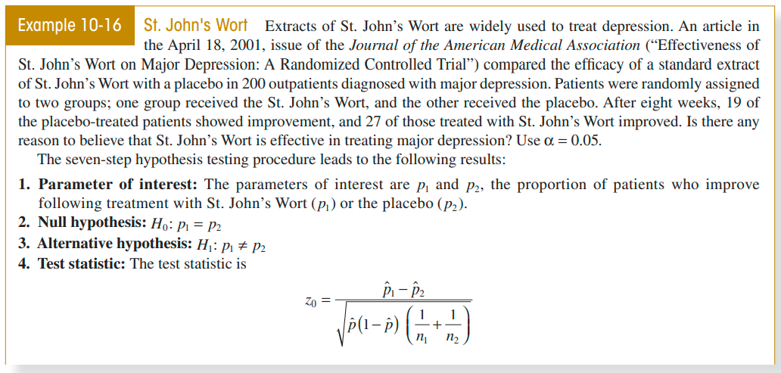

Slide 42
Summary
PHARAOH process
Parameter
Hypotheses: H₀ vs H₁
Related to a test statistic
A random sample
Obtain the P-value
H₀: Reject or fail to reject

